Slide 1
Politics & Pre-Existing Divides Effects on Covid-19
Presentation by “Group Sixers”
To GWU Data Boot Camp Class
November 14, 2020

Slide 4
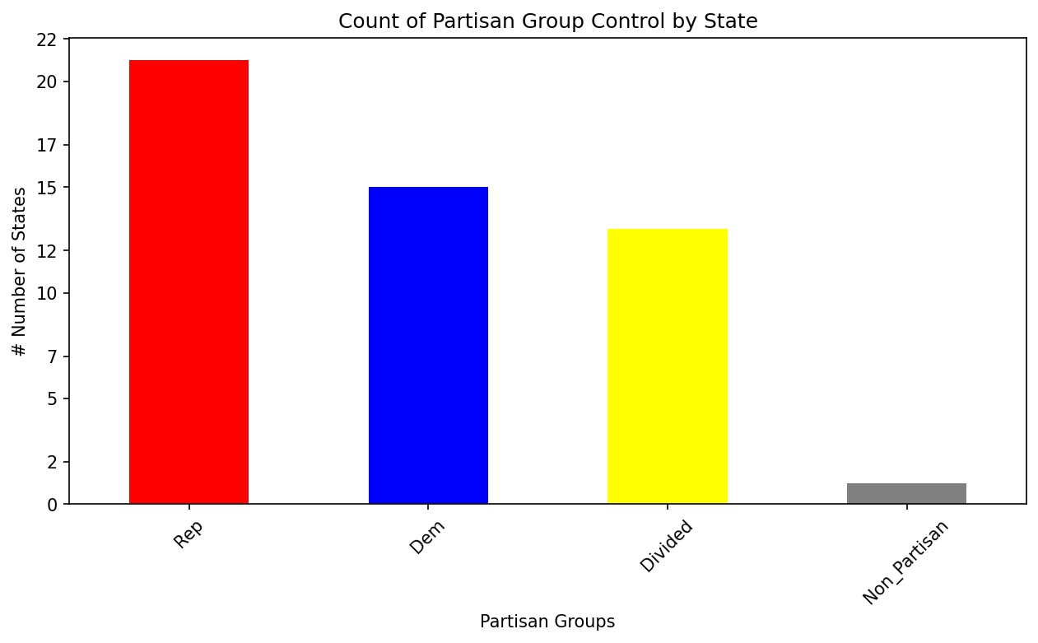
Does a state’s partisan control impact short term unemployment during Covid-19?
3 variables:
Partisan control at state level
Number of Covid-19 cases
New cases per 100,000 (avg per state)
Unemployment rate
Insured Unemployment Rate (avg rate per state)
“The number of people currently receiving unemployment insurance (UI) as a percentage of the labor force.” - stlouisfed.org
Is the partisanship of a state correlated to the state’s unemployment rate?
Can we correlate the number of covid-19 cases to the unemployment rate?
Sources:
Unemployment claims by state.csv - https://oui.doleta.gov/unemploy/claims.asp
Covid cases by state.csv - https://catalog.data.gov/dataset/united-states-covid-19-cases-and-deaths-by-state-over-time

Slide 5
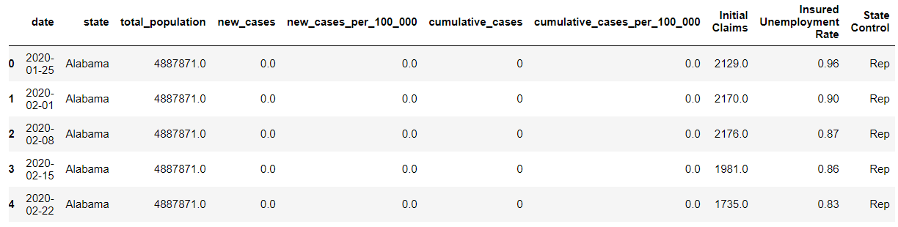
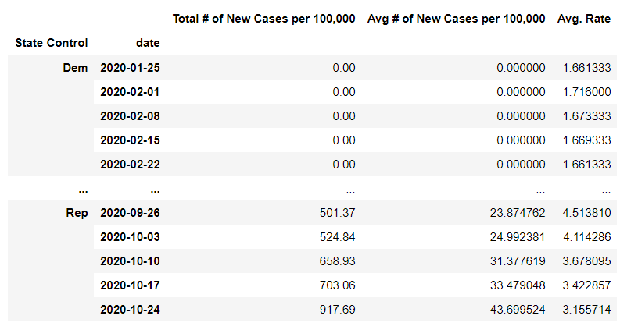
Data Cleanup & Exploration
Compile data:
Import and read CSVs
Merge CSV’s together into 1 data frame
Change any Nan values to 0, along with user friendly column labels
Format data for analysis:
Group the combined df by partisanship and date to track over time
Apply the ‘mean’ functions to the columns of interest
New cases per 100,000
Avg unemployment rate
*‘Sum’ vs ‘Mean’ function*
* ‘Cumulative’ vs ‘New’ cases*

Slide 6
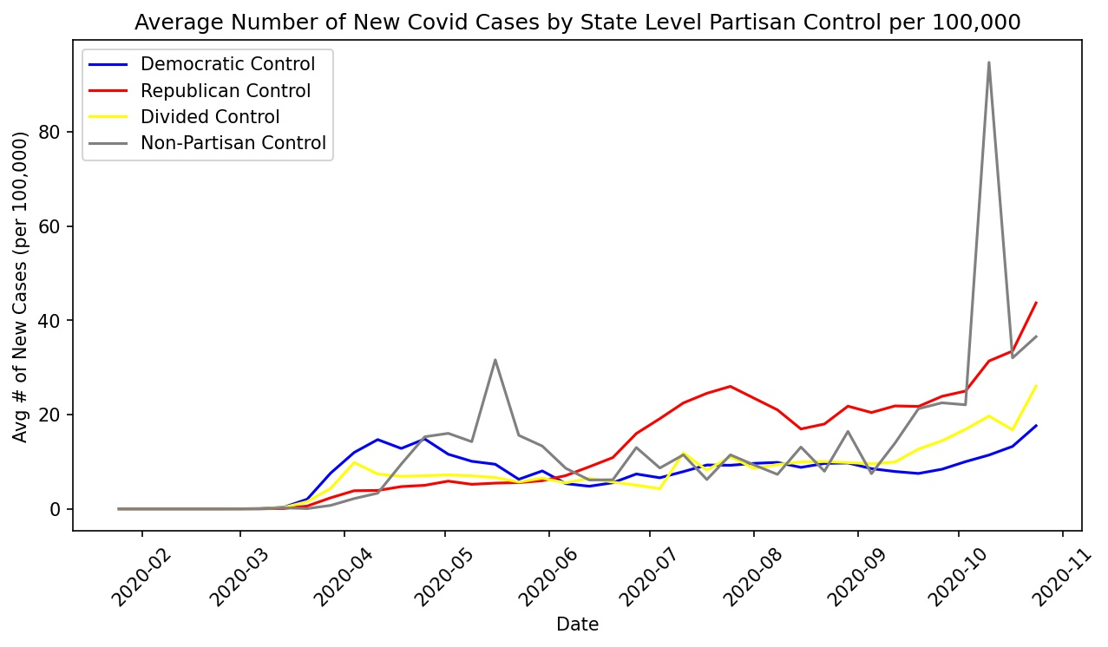
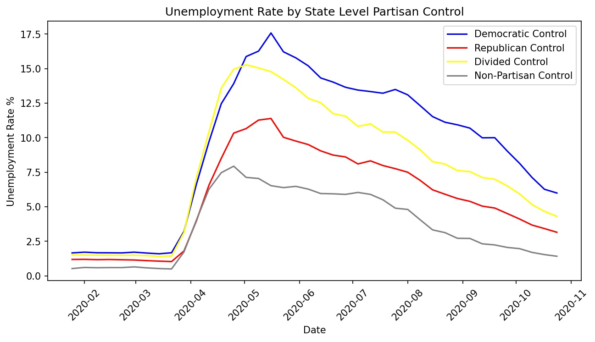
Insured Unemployment Analysis
In the top graph, we analyzed the average number of new covid cases per month
Democratic states had higher rates in the earlier months
Republican states had higher rates in the later months, including a current strong upward trend
In the bottom graph, we analyzed the average insured unemployment rate per month
Democratic states experienced higher rates of unemployment
Republican states experienced lower rates of unemployment

Slide 7
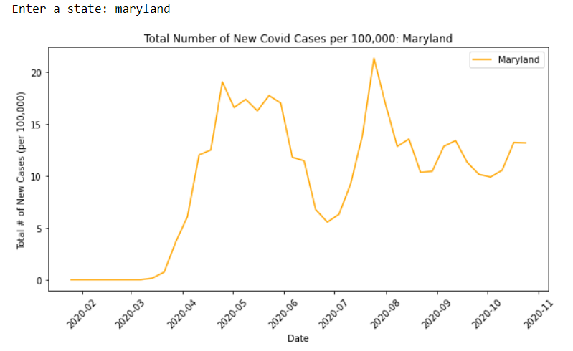
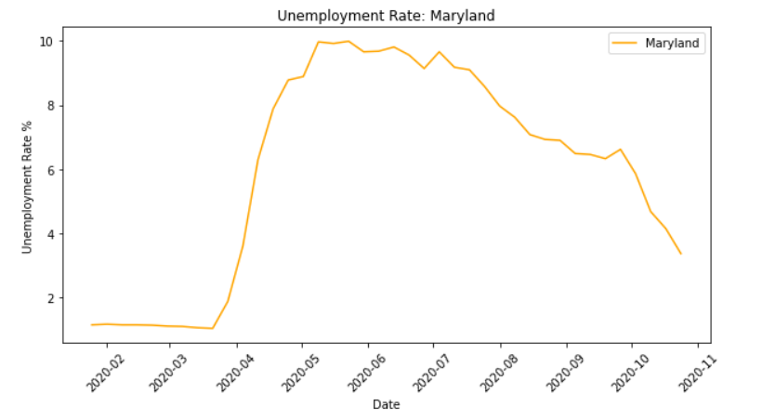
Analysis at State Level
Taking our analysis one step further, we created code for the user to input a specific state
- The plots are easily updatable for each state
We plotted the same data variables for that specific state

Slide 8
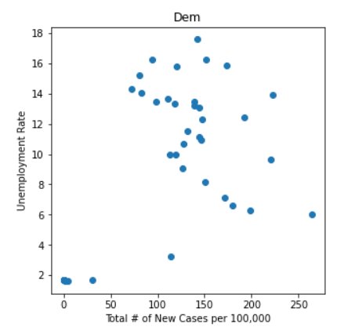
Unemployment Implications
Based on the data, we can imply:
Democratic states took a more direct / cautious approach to the fight against covid
Stronger shut downs and regulations
Republican states took an approach less disruptive to businesses
These findings are in line with our expectations, as well as the general partisan political views
Other considerations:
Did Democratic states open more testing sites opposed to republican states?
Were there actually harder written policies set in place for democratic states?
Difficulty plotting scatter plots, as time seems to be a huge factor

Slide 9
Conclusions and Imact

Slide 10
Difficulties and Further Considerations

